Slide 1
Health Care System
Problem Statement
To create a user-friendly java application for a Health Care System.

Slide 2
Created By
Pankaj -> User Management
Mohd Ikram -> Appointment Management
Upender -> Diagnostic Center Management
Praveena -> Test Management

Slide 3
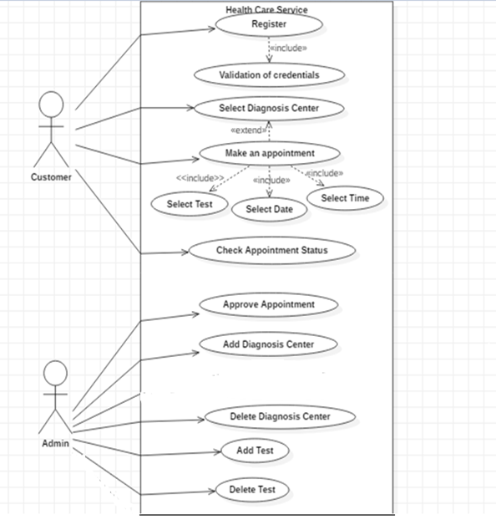

Slide 4
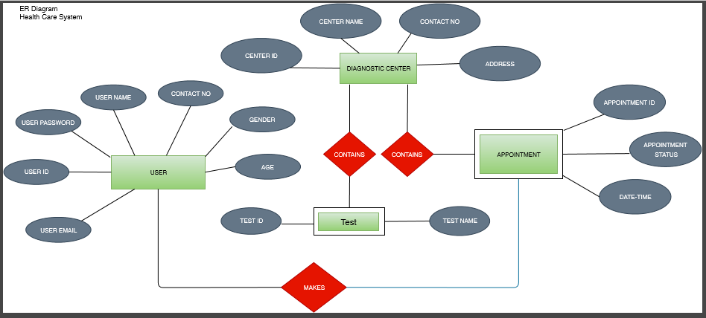

Slide 5
User Management
Registration-> User
Login - > Admin, User
Logout -> Admin, User

Slide 6
UI Screenshots

Slide 7
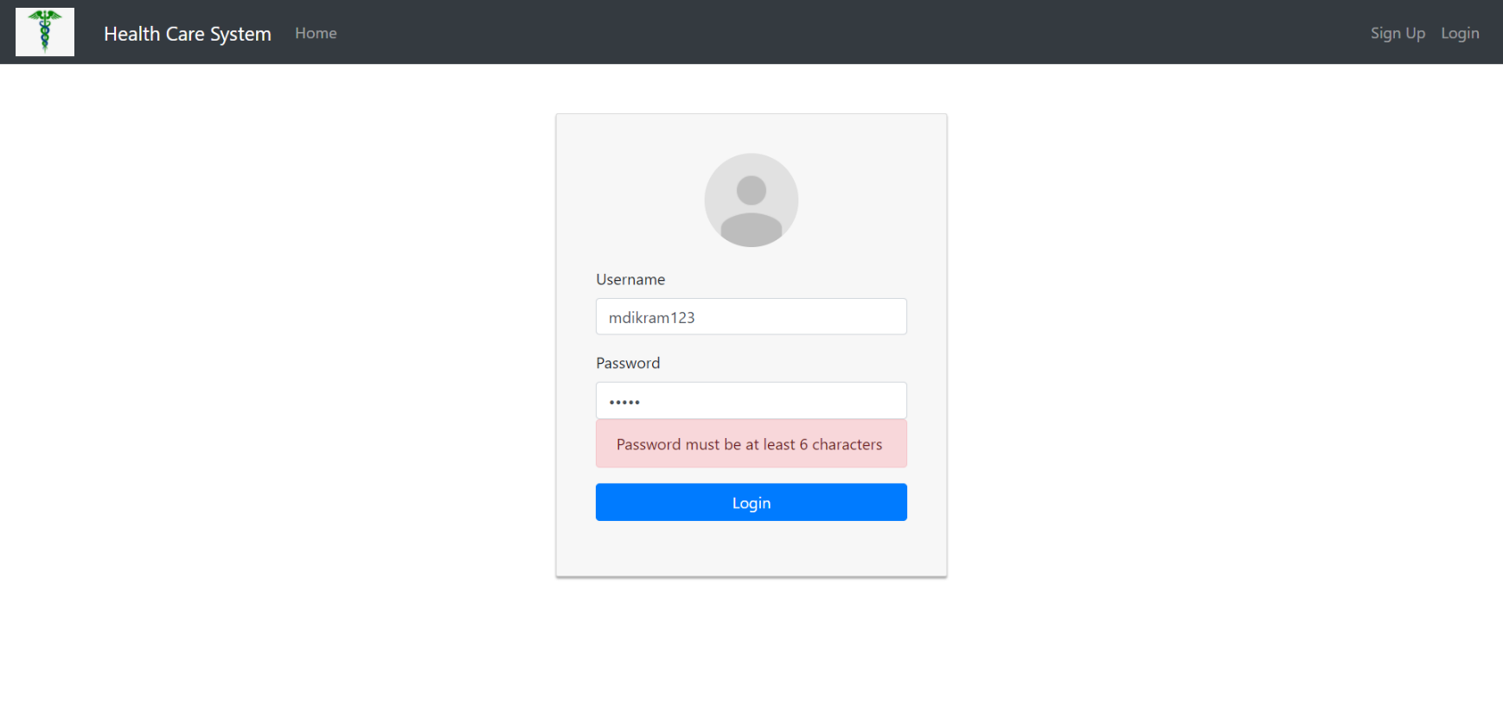

Slide 8
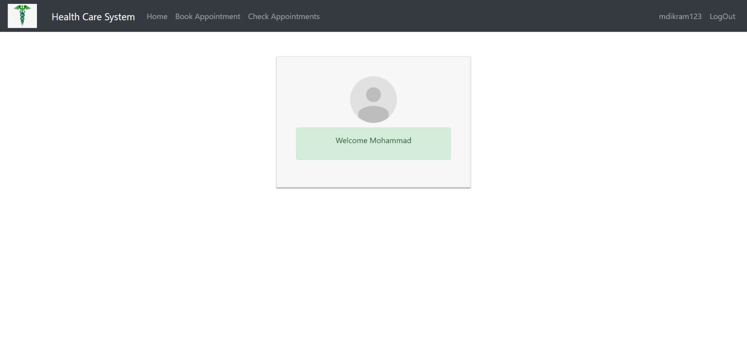

Slide 9
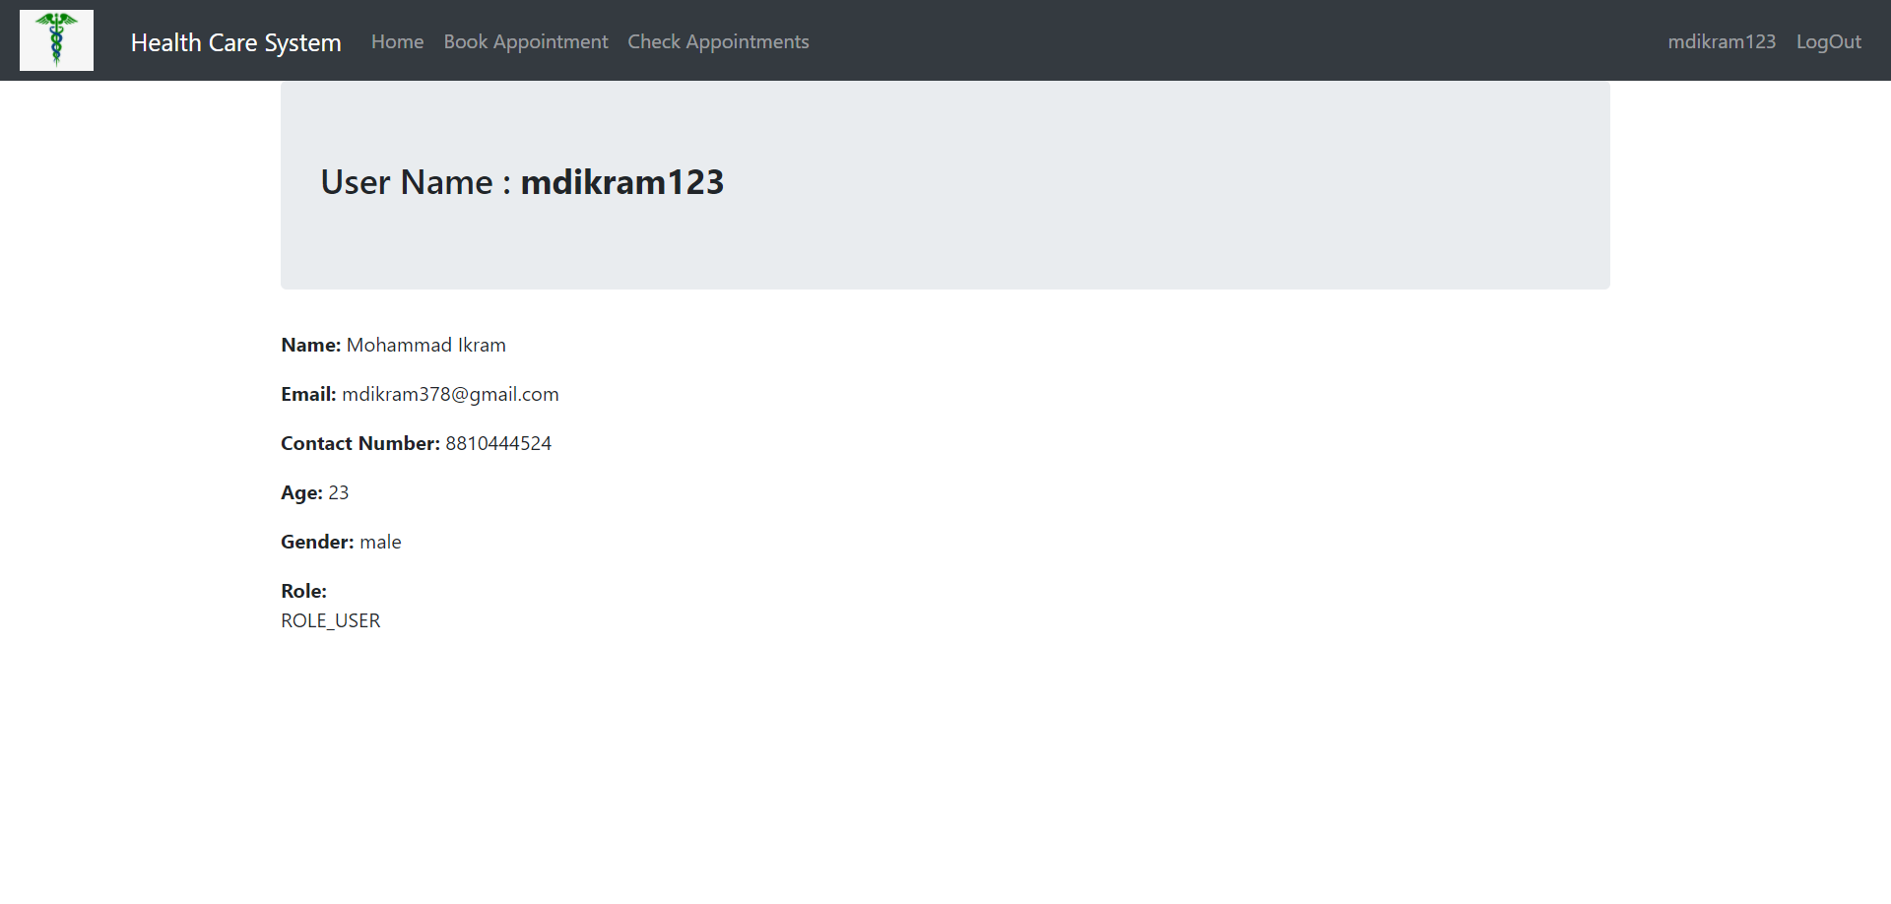

Slide 10
Class Diagram

Slide 11
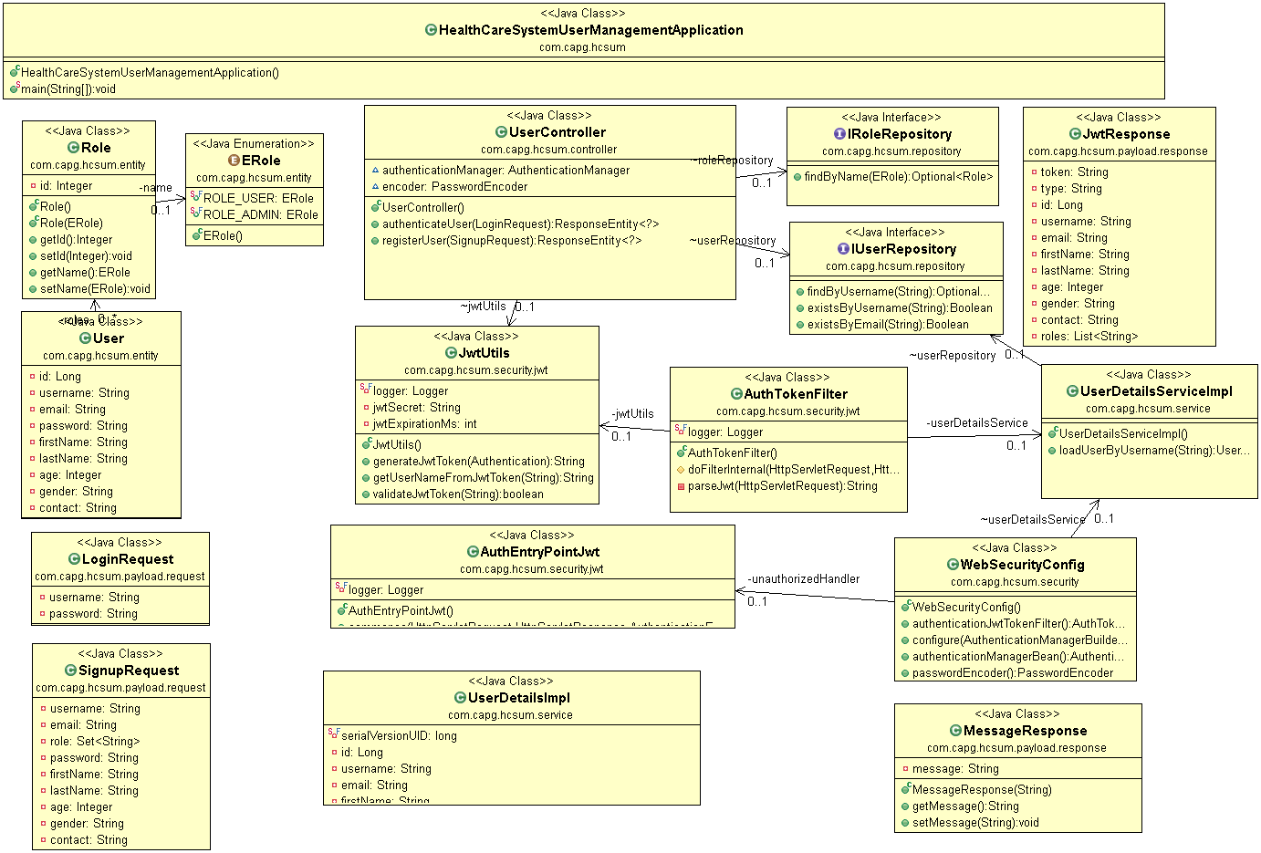
Class Diagram

Slide 12
Appointment Management
Create a appointment -> User
Check appointment -> User
Approve/Disapprove Appointment -> Admin

Slide 13
UI Screenshots

Slide 14
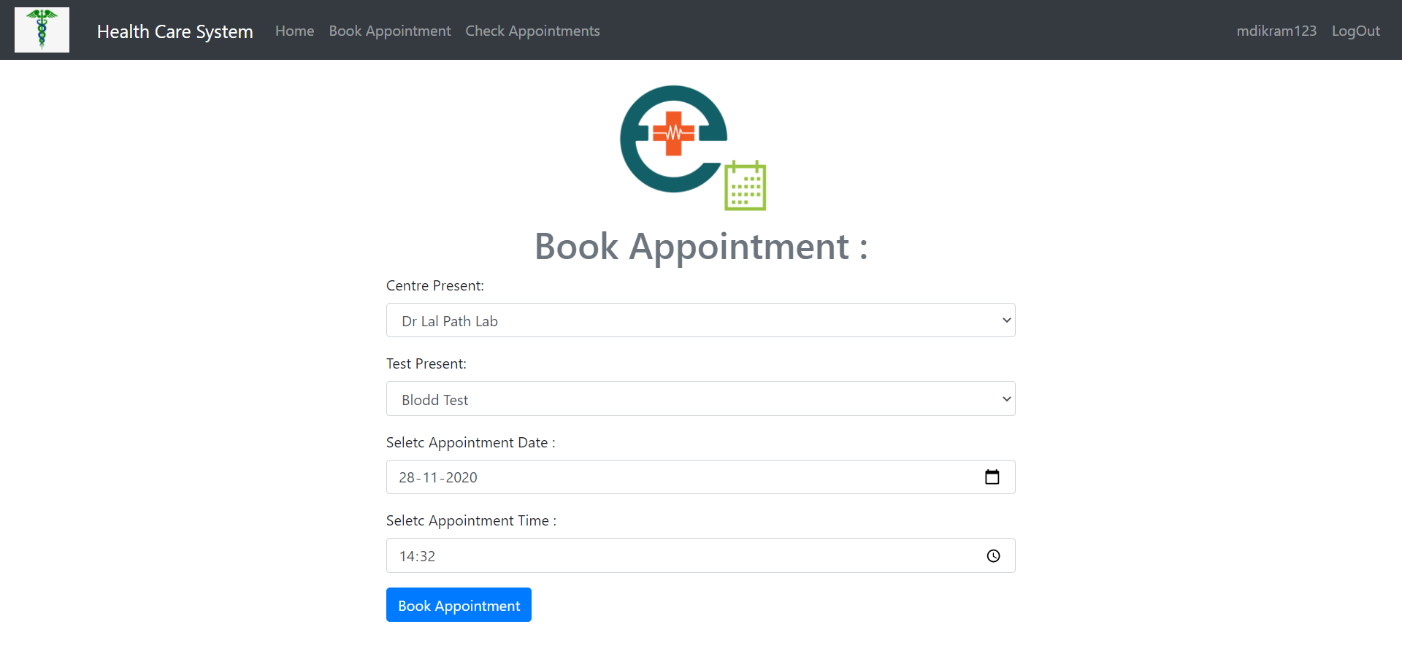

Slide 15
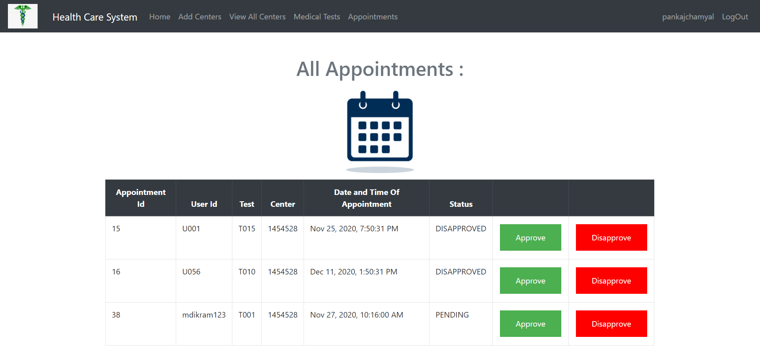

Slide 16
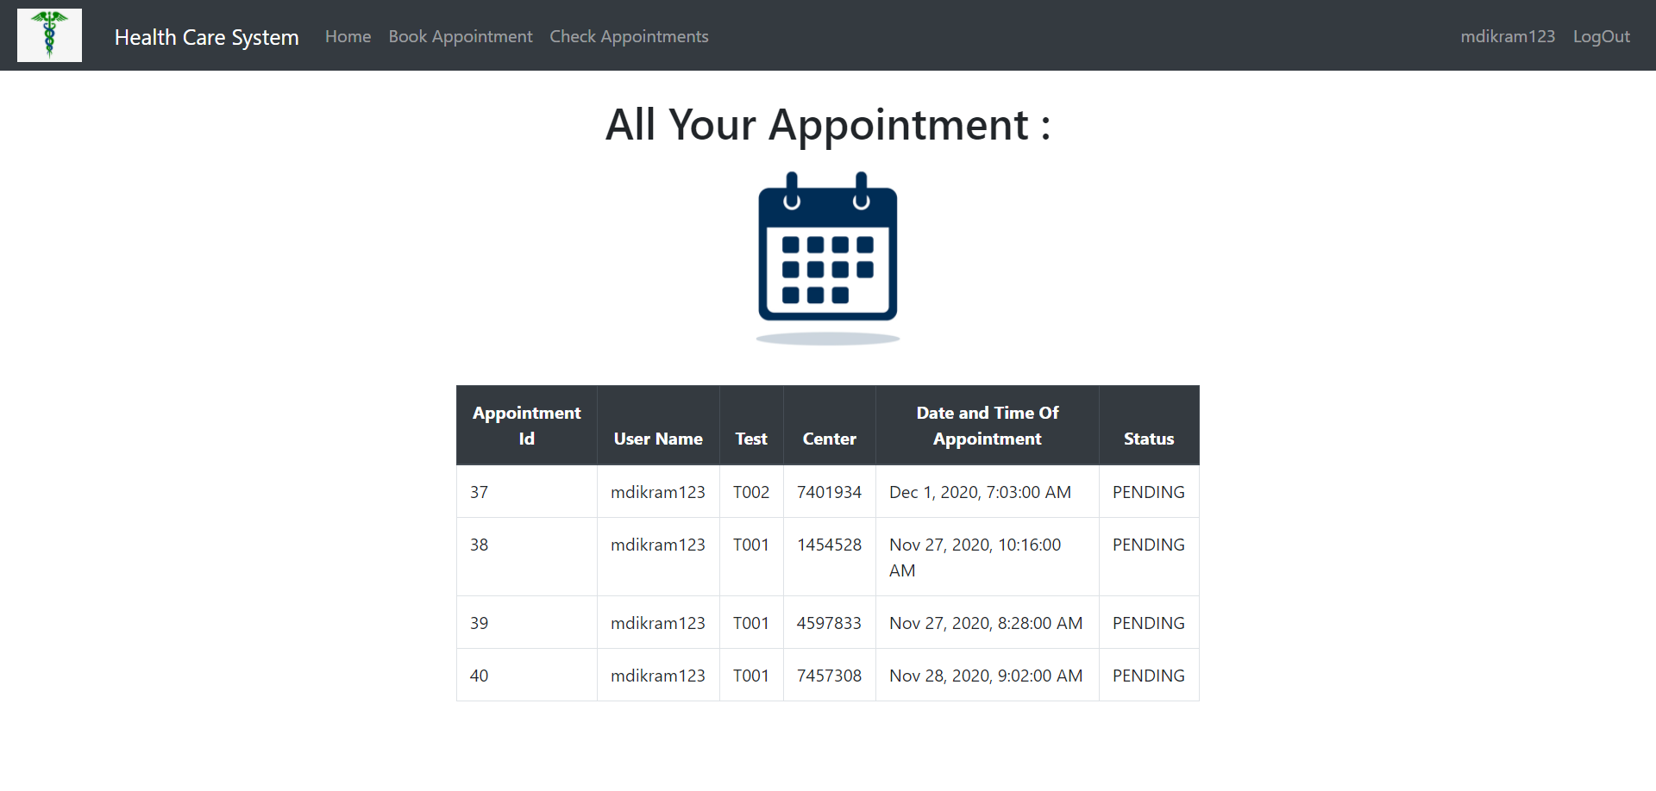

Slide 17
Class Diagram

Slide 18
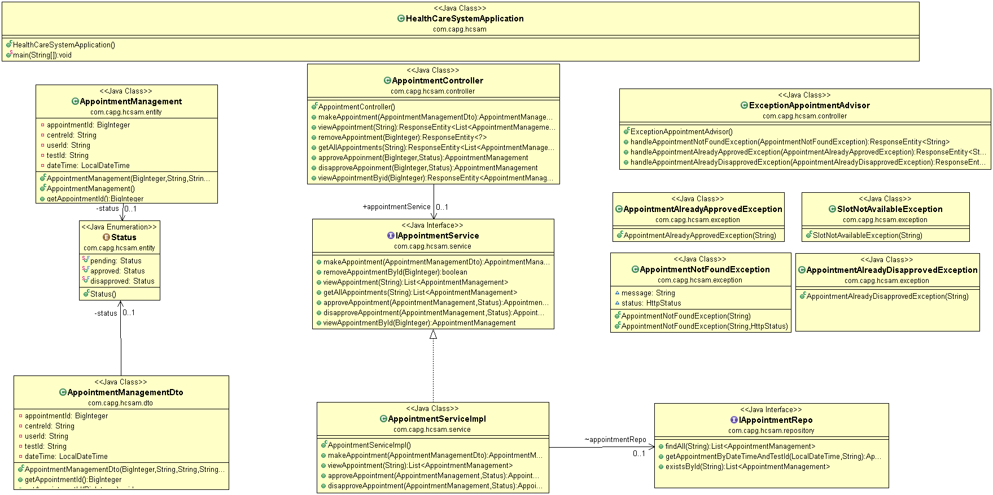

Slide 19
Center Management
Creating Diagnostic Center -> By Admin
Deleting Diagnostic Center -> By Admin

Slide 20
UI Screenshots

Slide 21
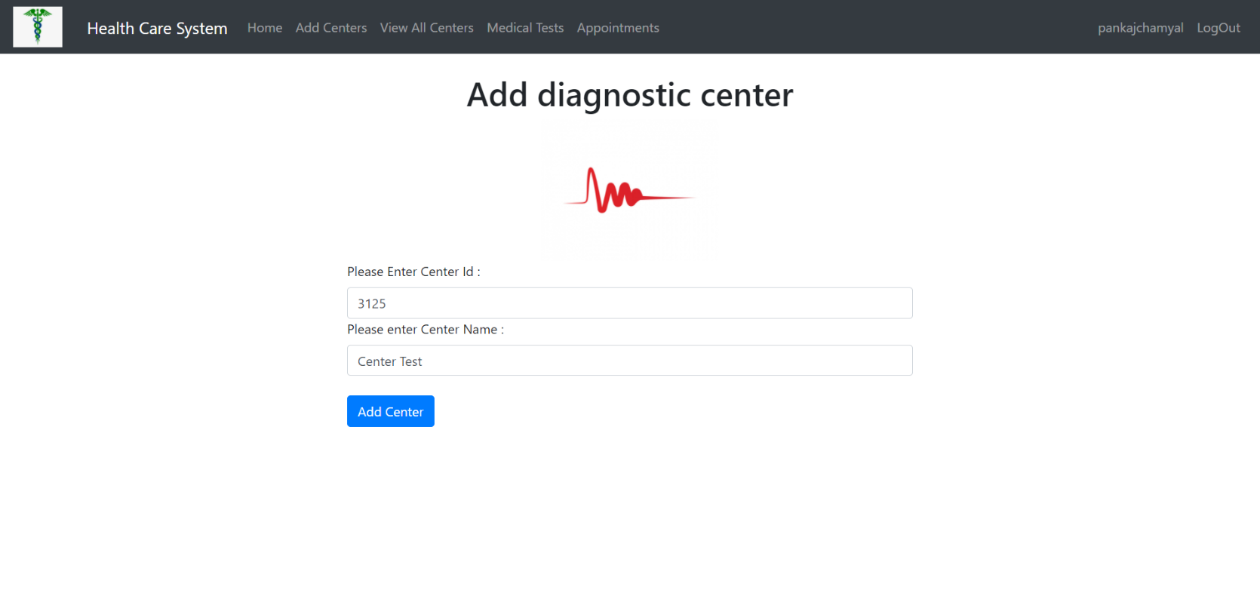

Slide 22
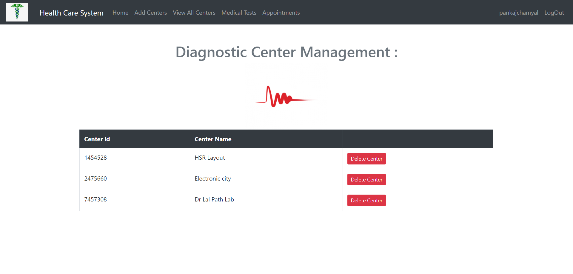

Slide 23
Class Diagram

Slide 24
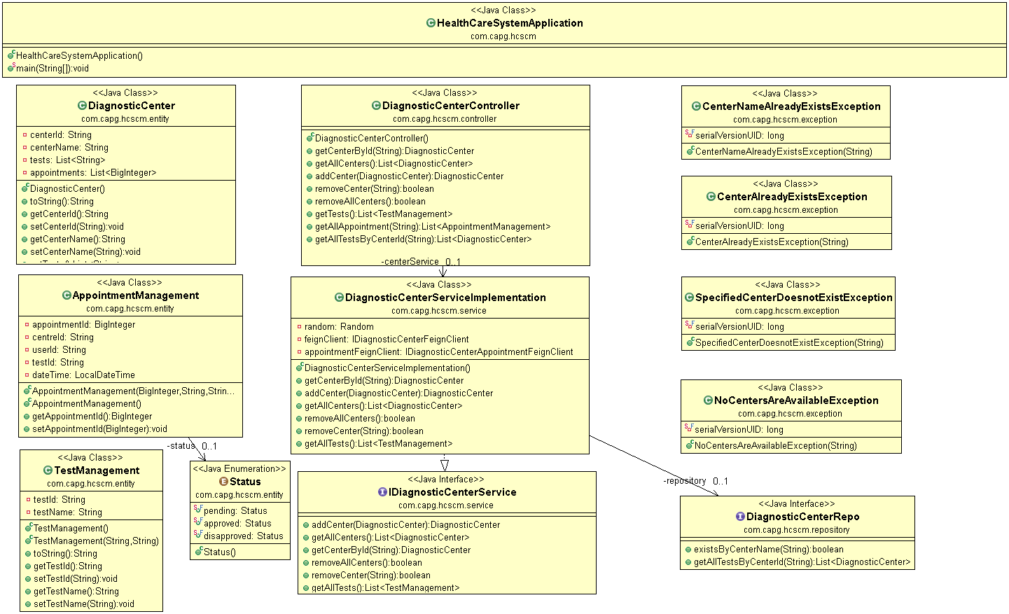
Class Diagram

Slide 25
Test Management
Adding Test -> Admin
Updating Test -> Admin
Deleting Test -> Admin

Slide 26
UI Screenshots

Slide 27
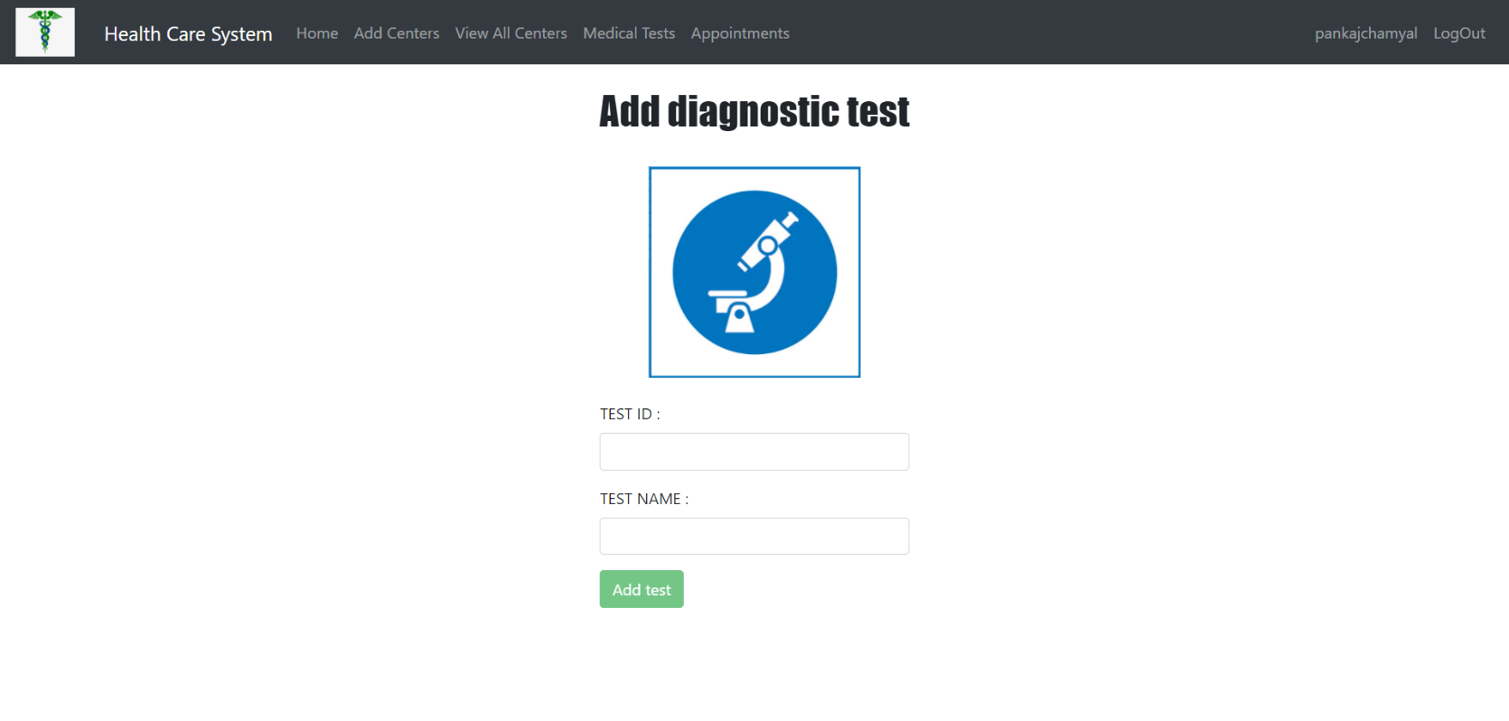

Slide 28
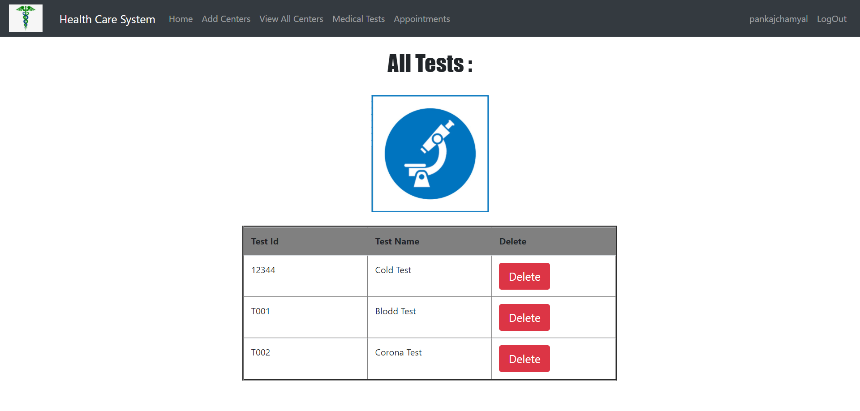

Slide 29
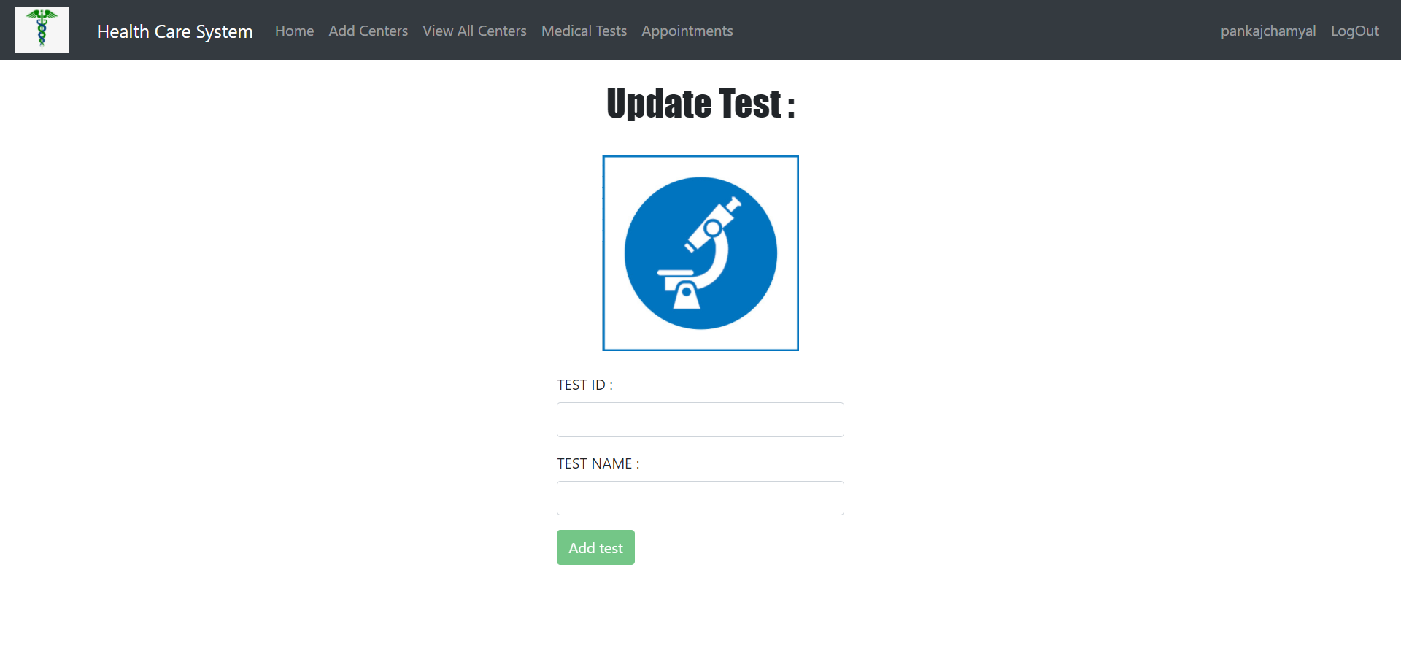

Slide 30
Class Diagram

Slide 31
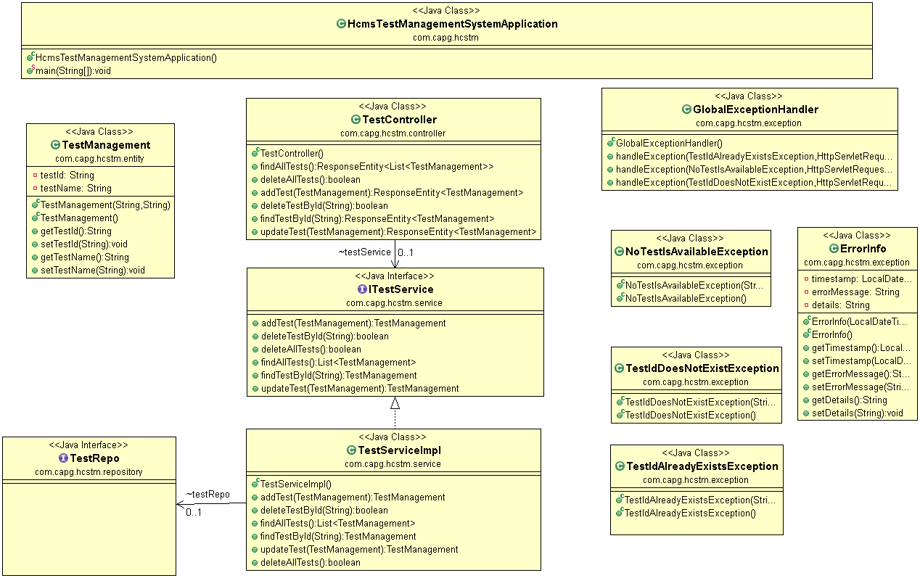
Class Diagram

Slide 32
Thank You

